Slide 1
Travel On a Dime
Peter Frantz – Recruiter – Federal Highway Administration
A Presentation for the 2024 Maryland FBLA State Leadership Conference

Slide 2
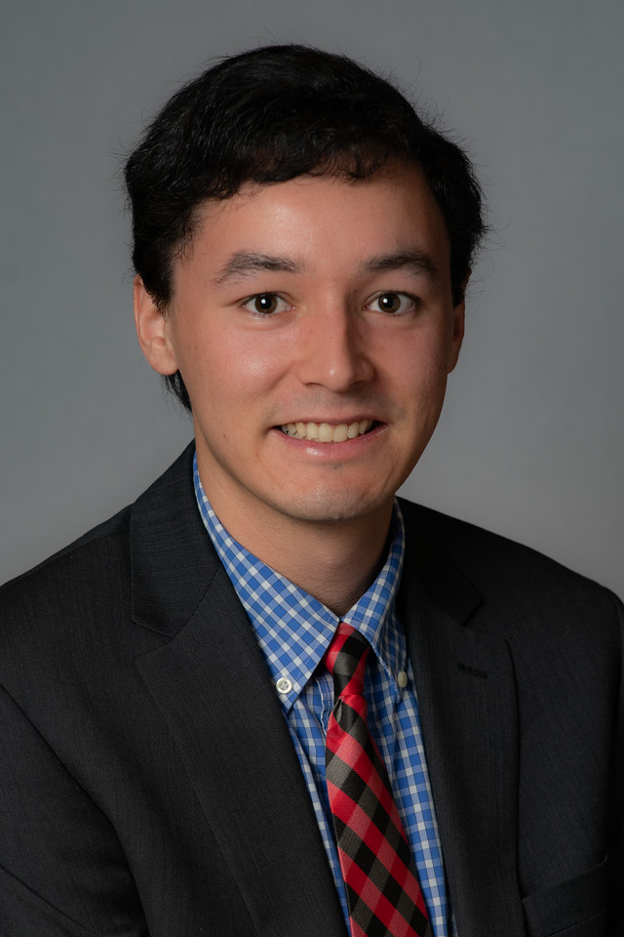
Travel On a Dime Introductions
My name is…I traveled from…
Peter Frantz…Washington, DC
I work for…
The Federal Highway Administration (FHWA)
I went to…
The University of Maryland

Slide 3
Travel On a Dime An Agenda for Today’s Presentation
Navigating Your Way Around Cities Using Public Transportation
Comparison Shopping Airfare to “Fly the Friendly Skies” for Less
Price Match Programs to Save Money on Hotel Stays
“Travel Hack” for Purchasing Tickets with Frontier, Spirit, and the Ultra Low-Cost Carriers

Slide 4
Travel On a Dime Google Maps, Hopper, Skiplagged

Slide 5
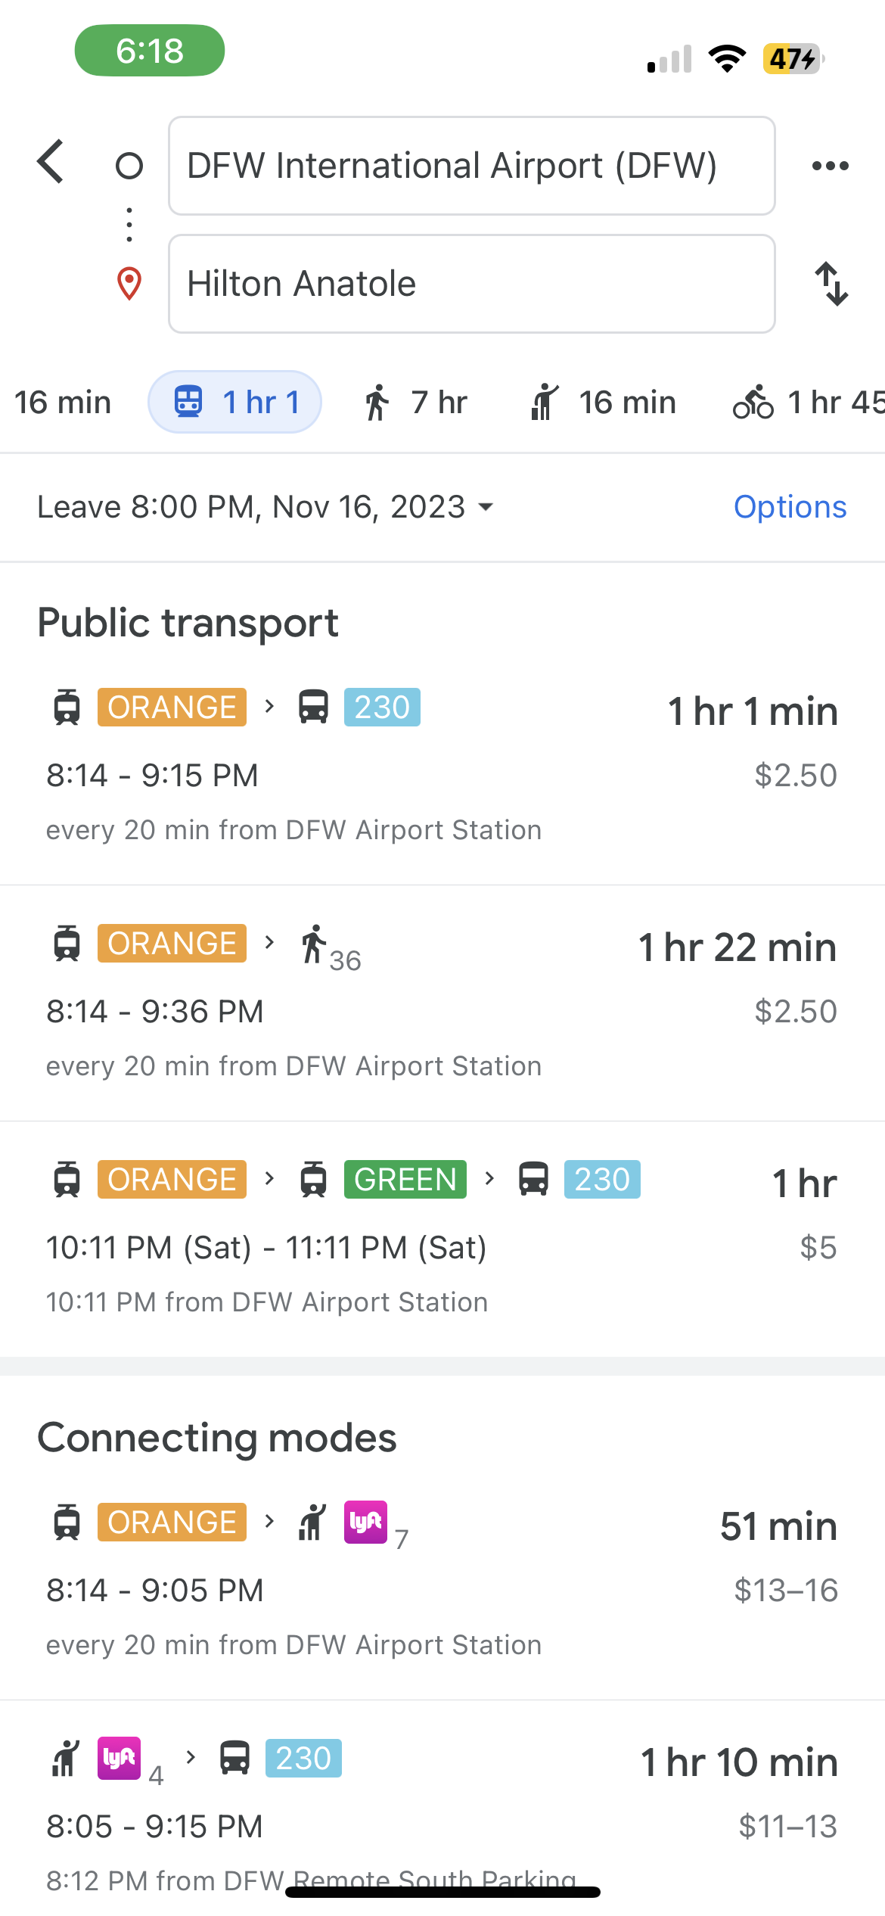
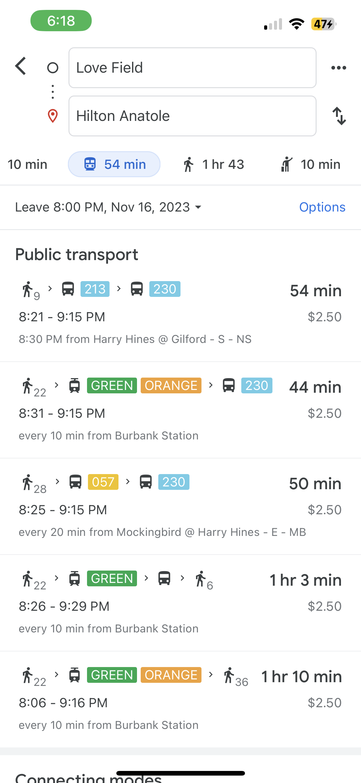
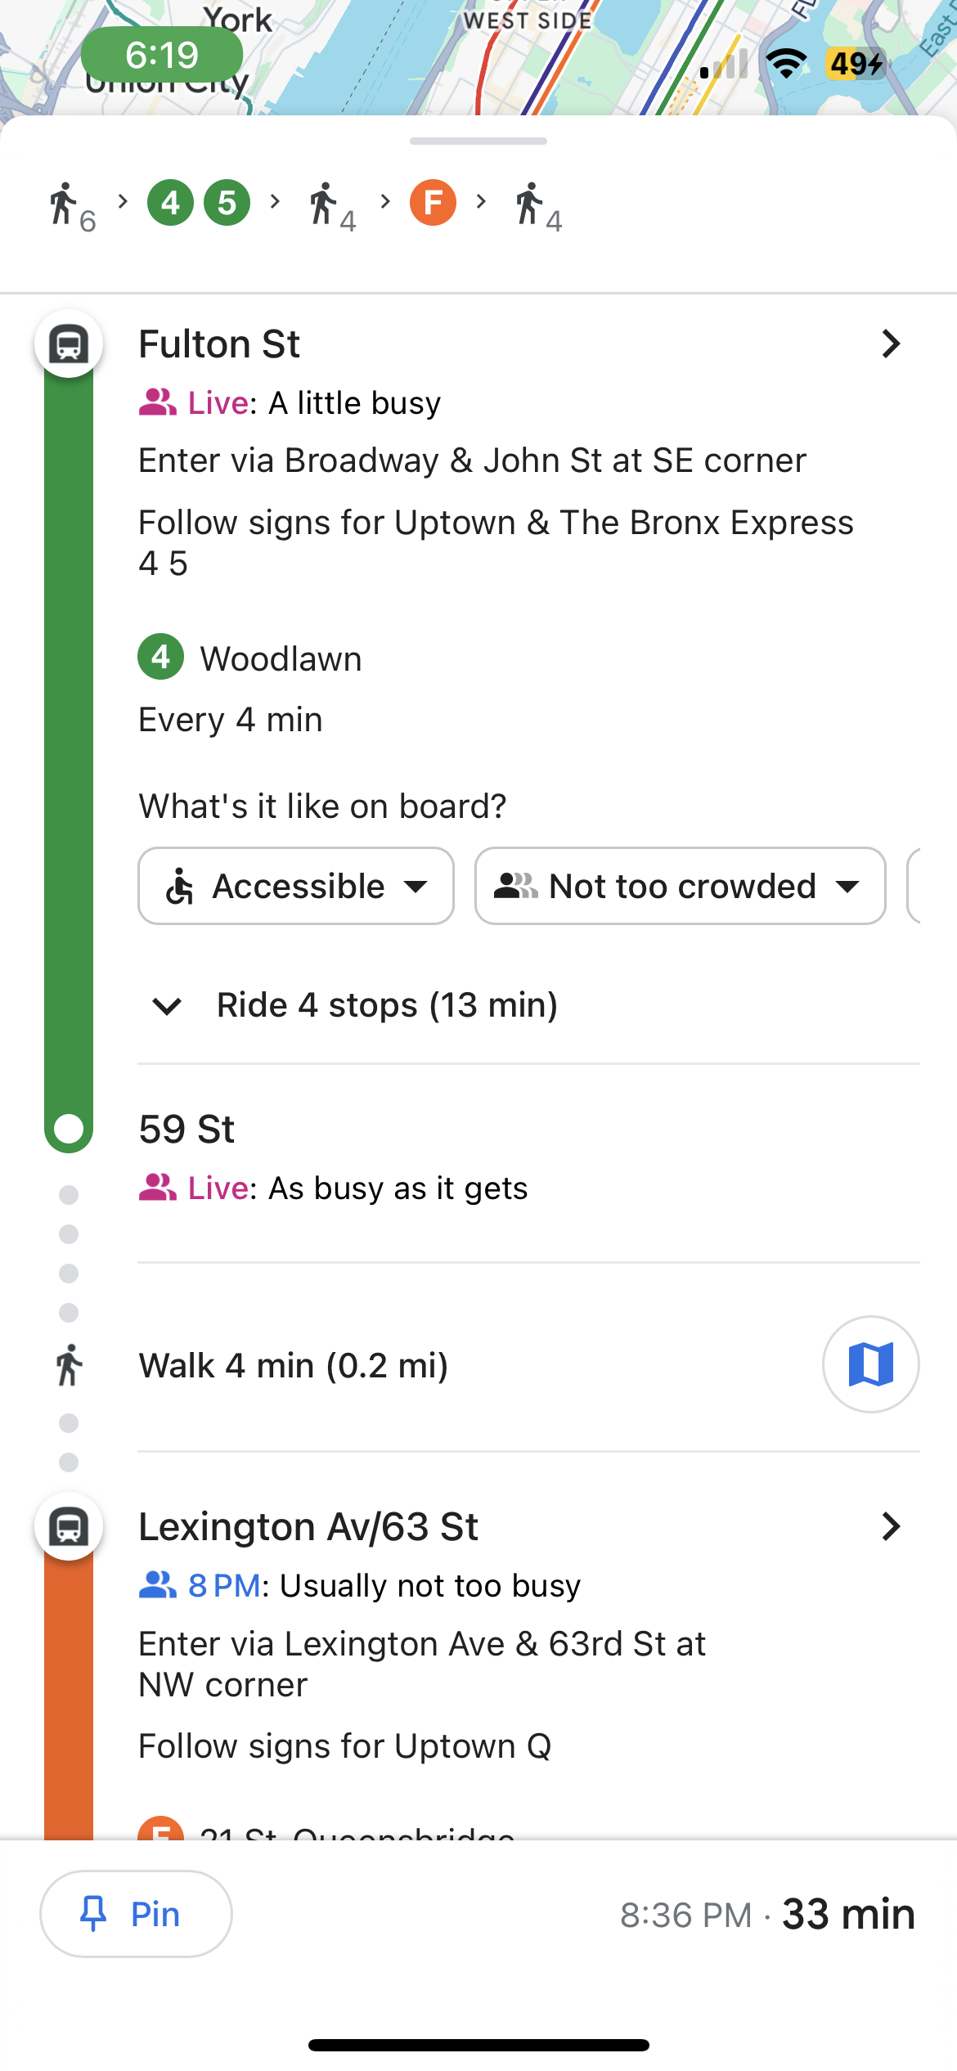

Slide 6
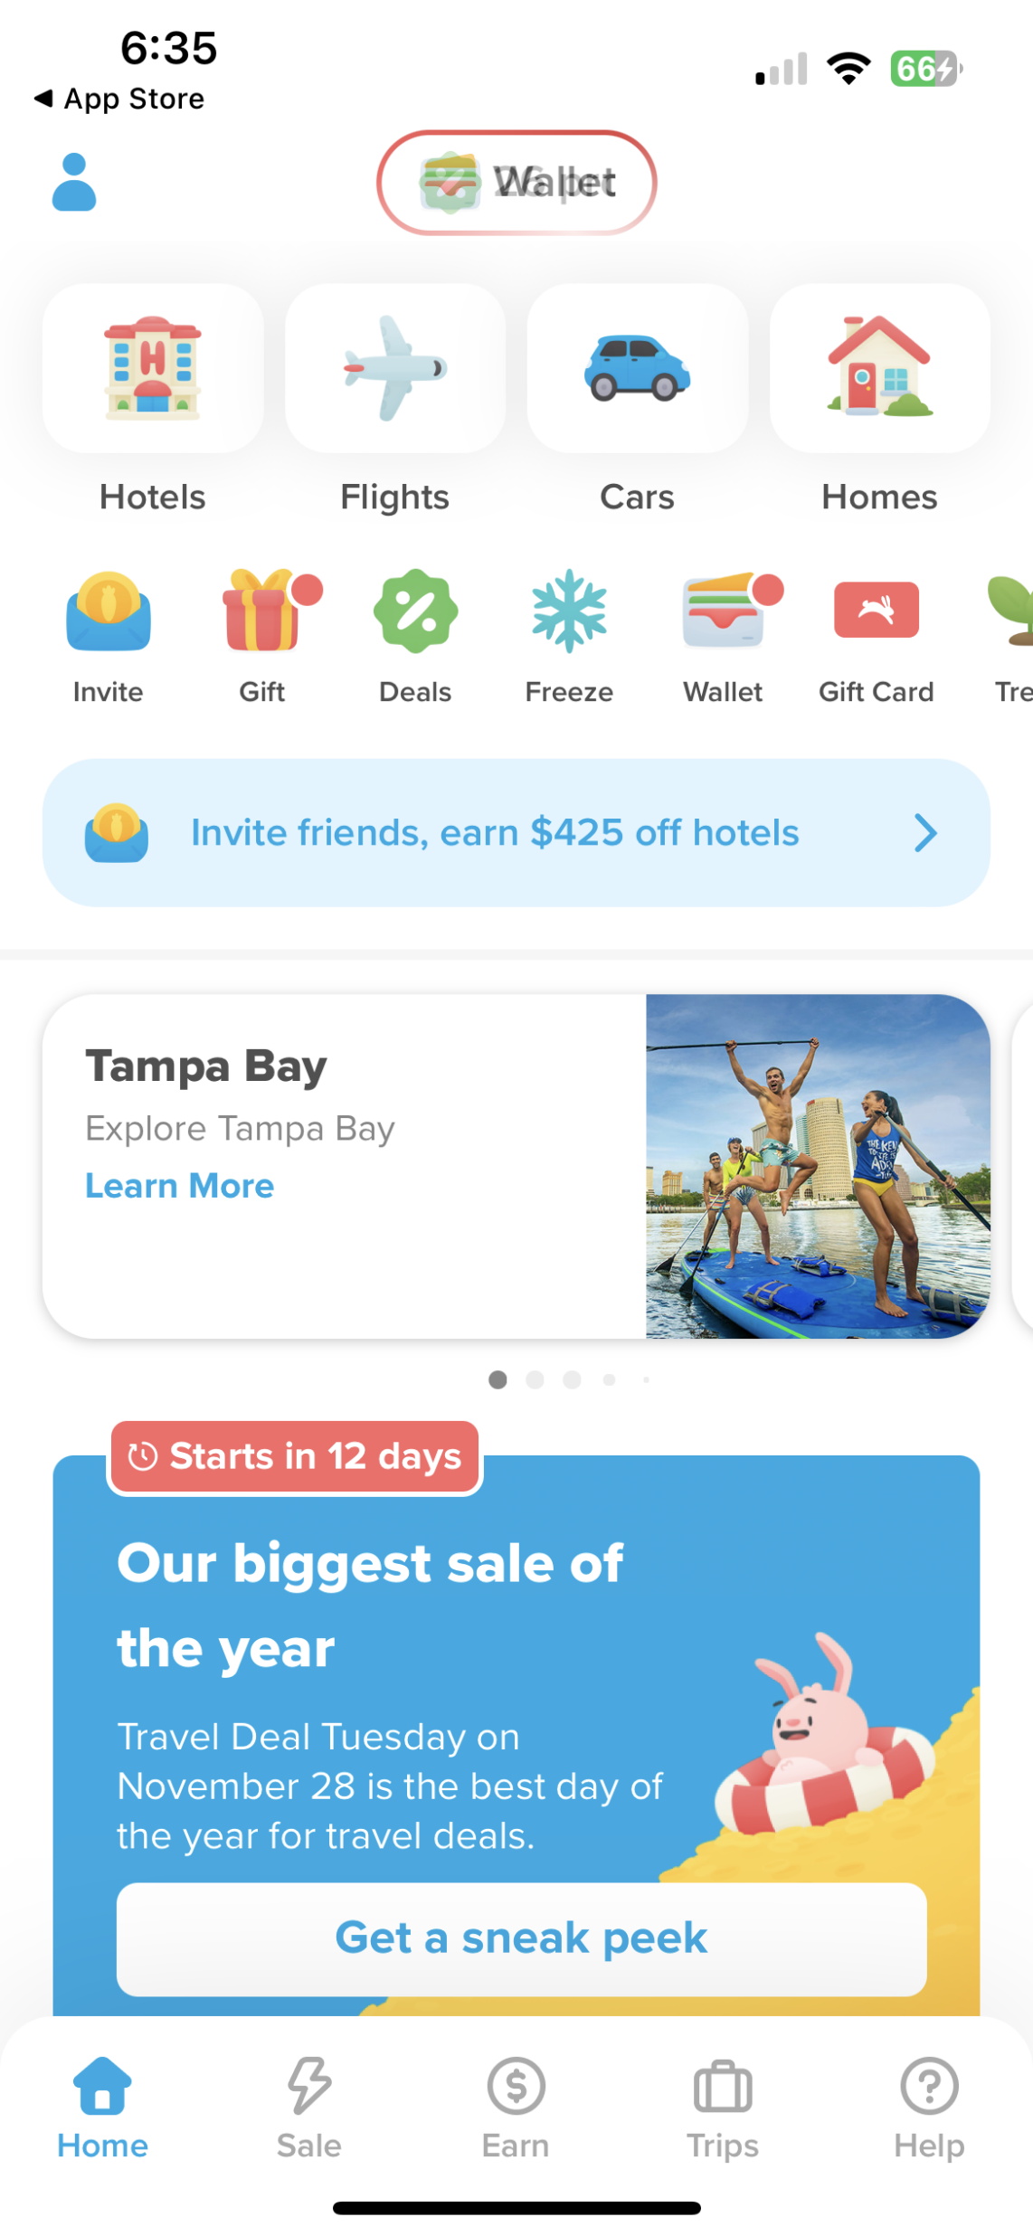
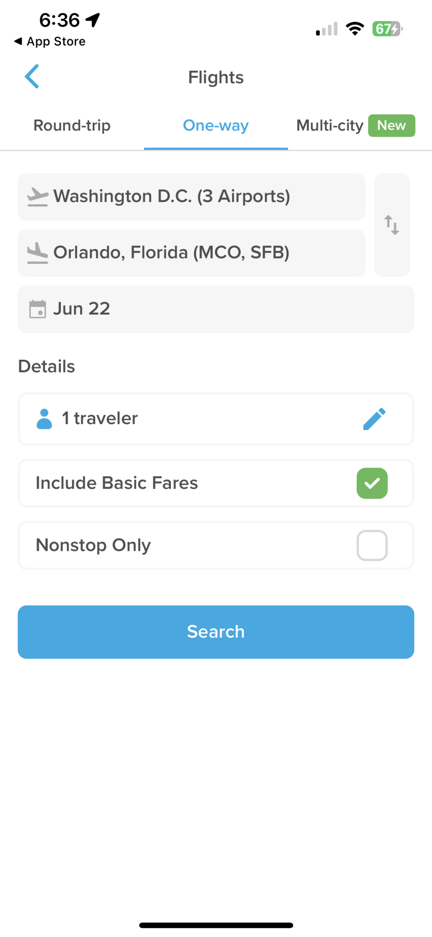
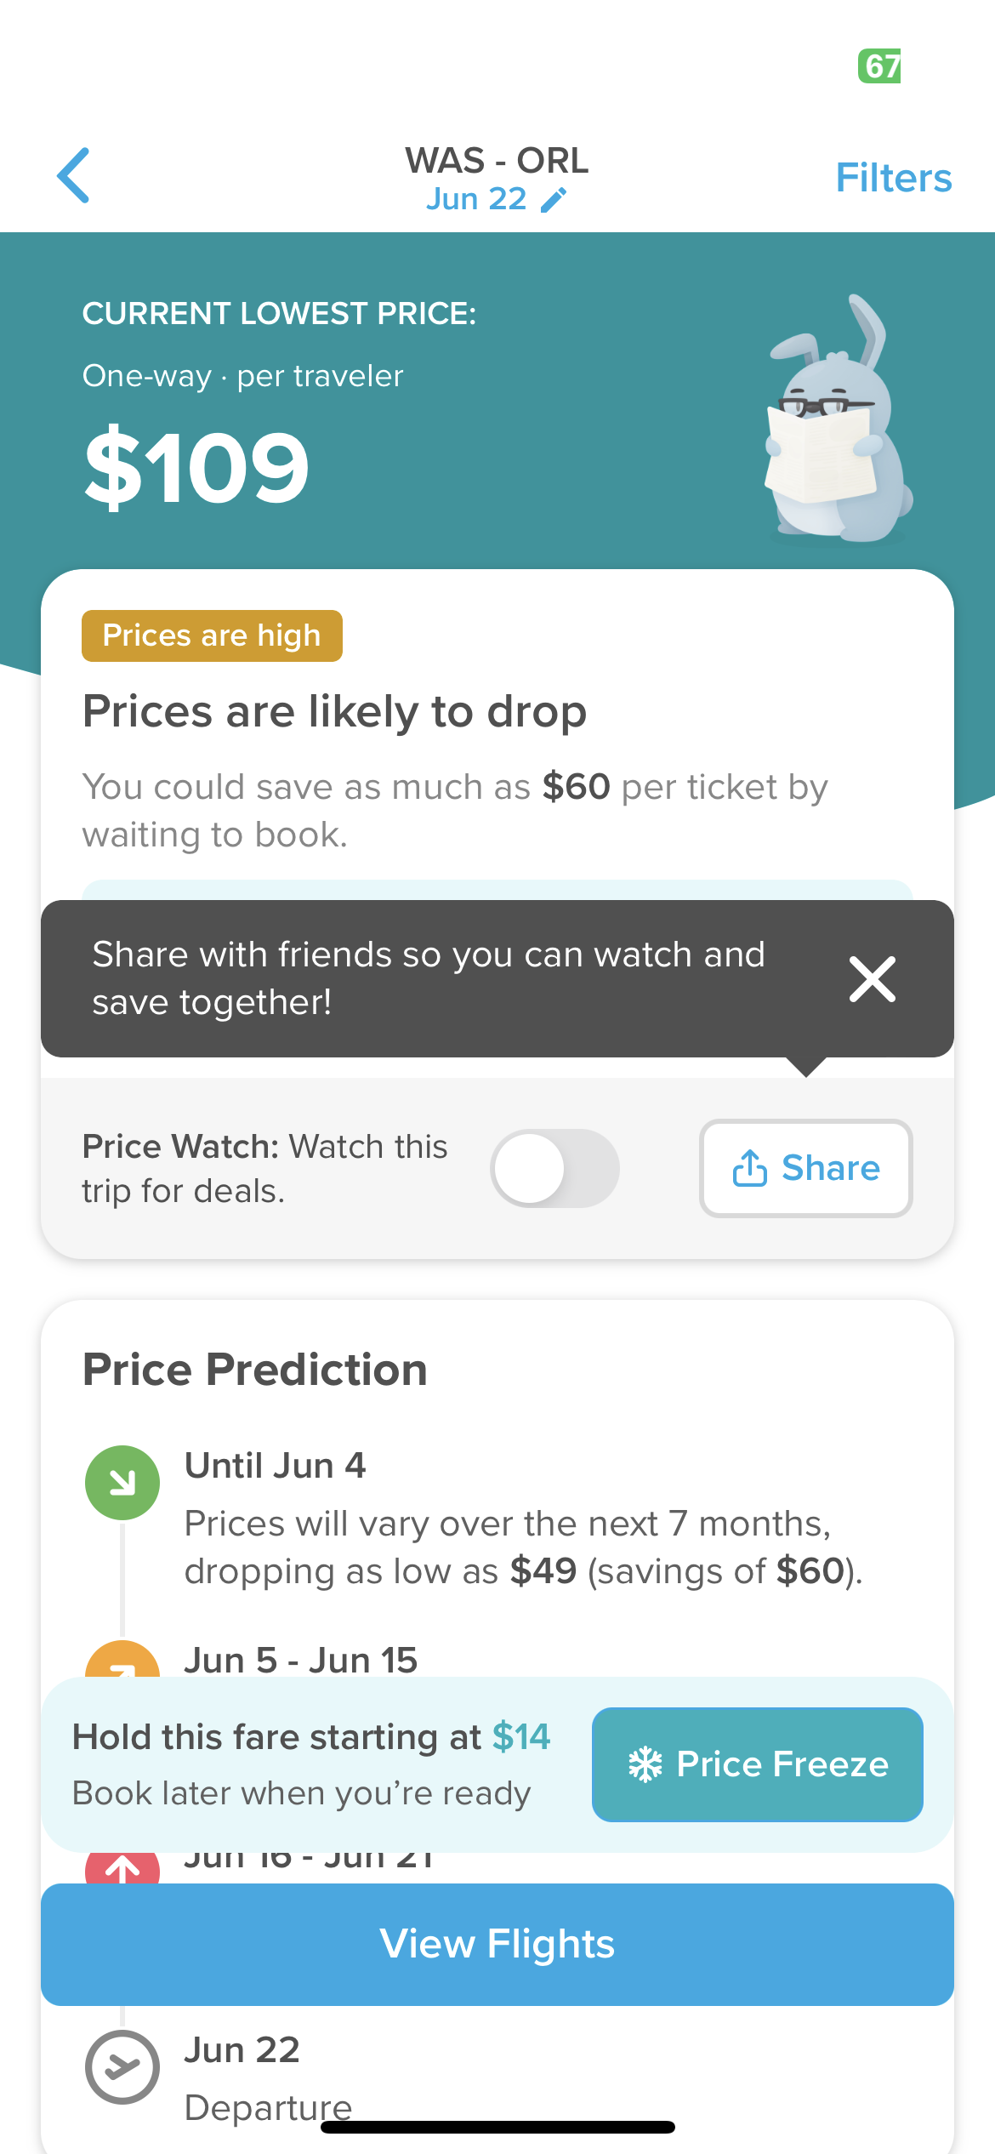

Slide 7
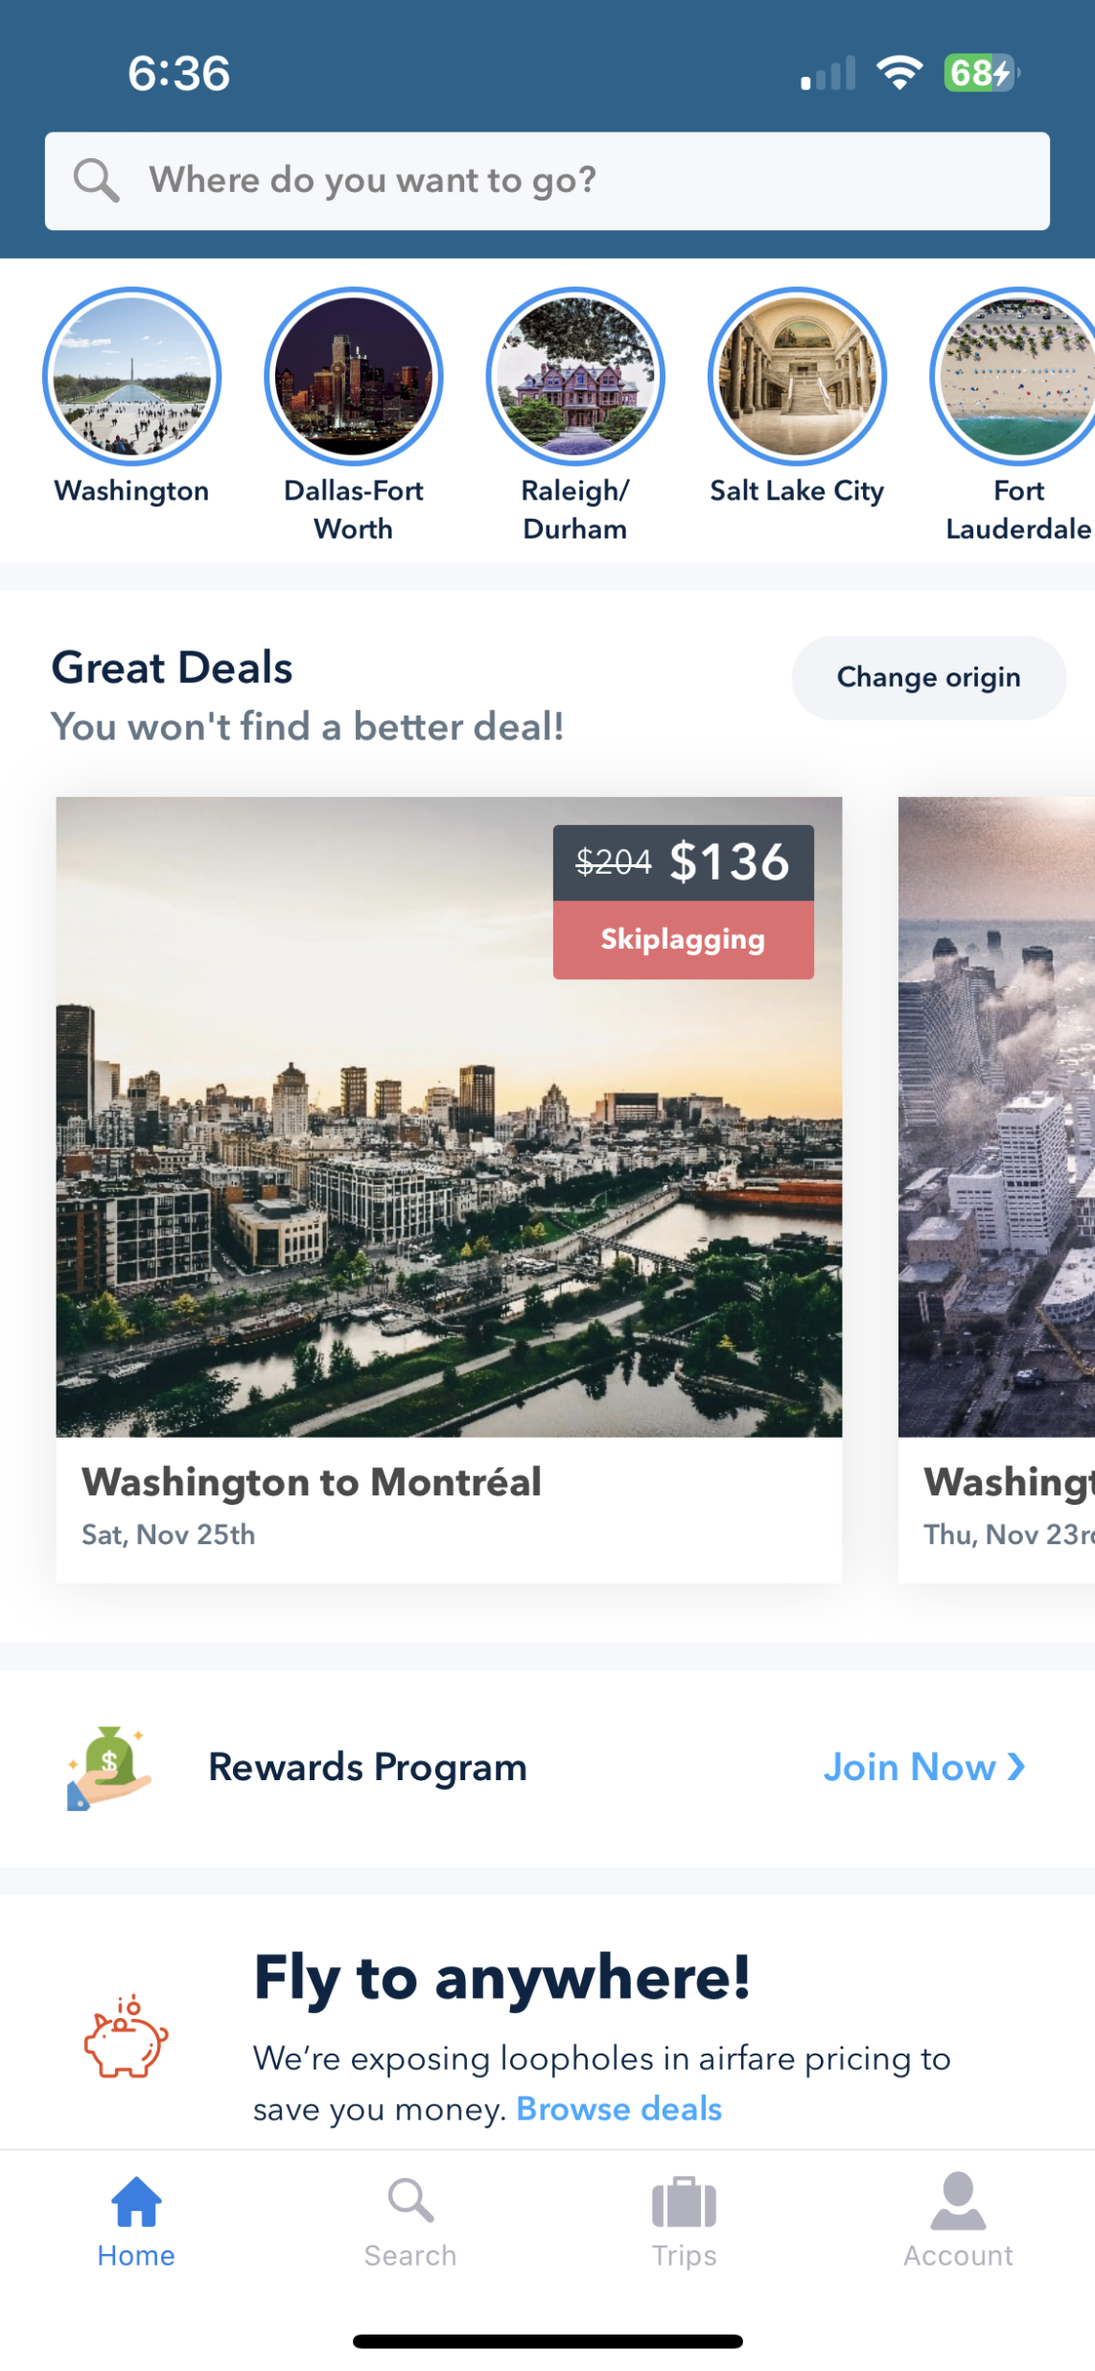
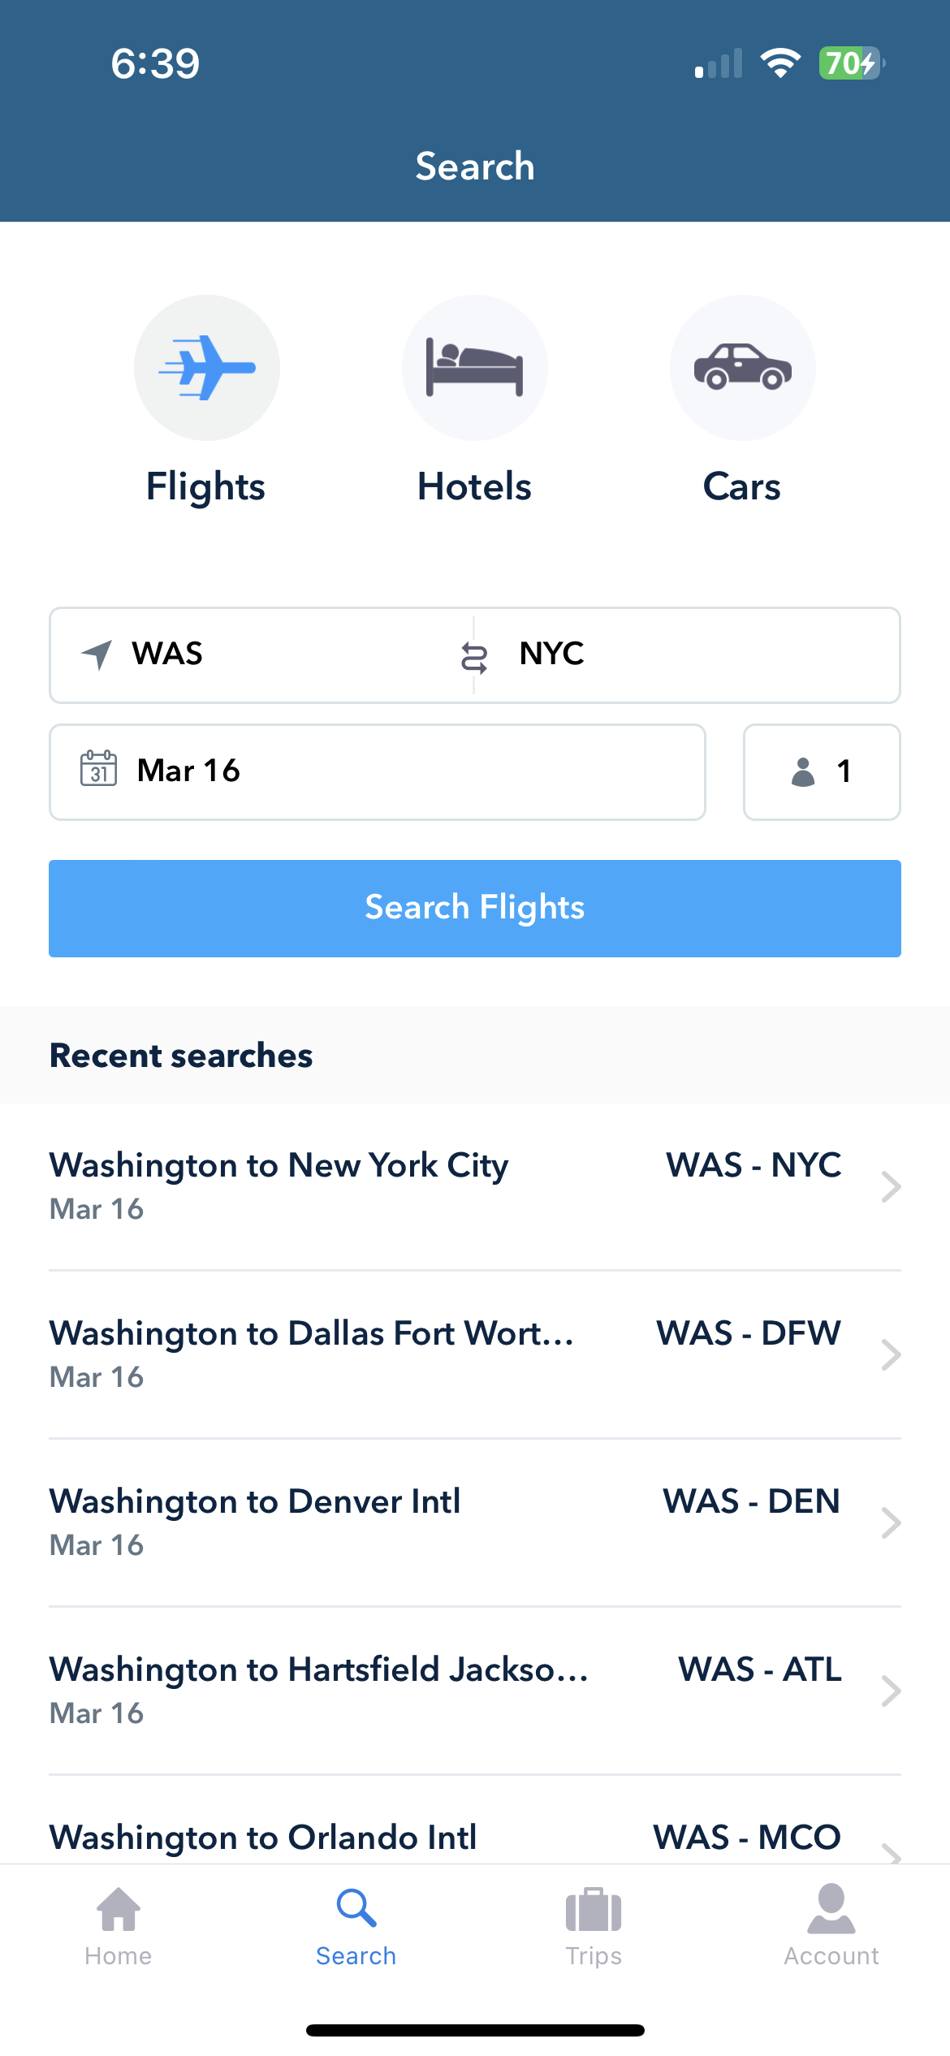
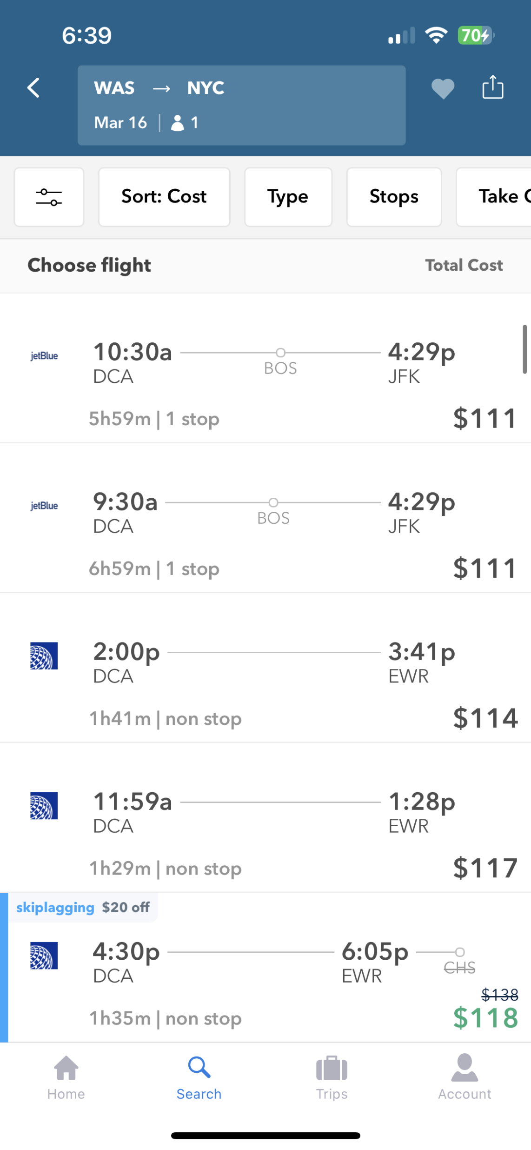

Slide 11
Travel On a Dime Price Match Guarantees

Slide 12
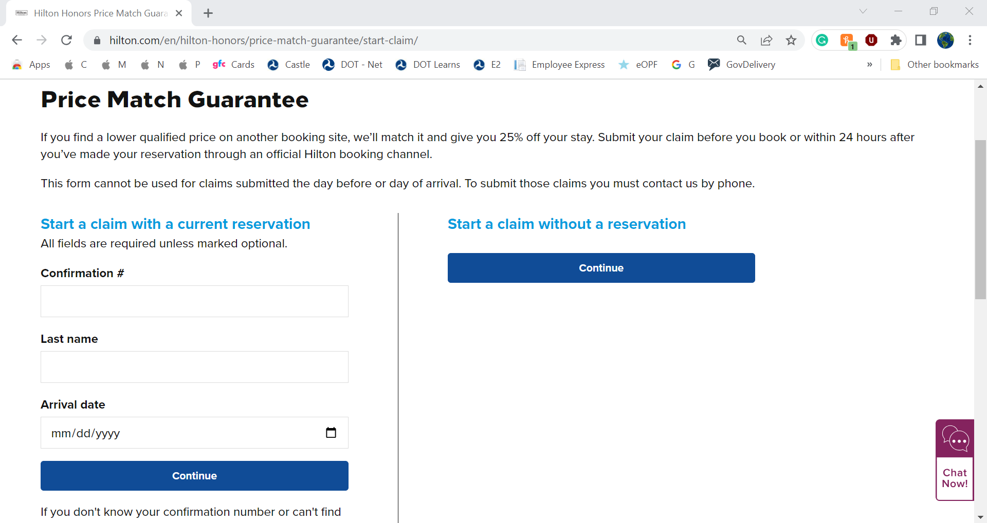

Slide 13
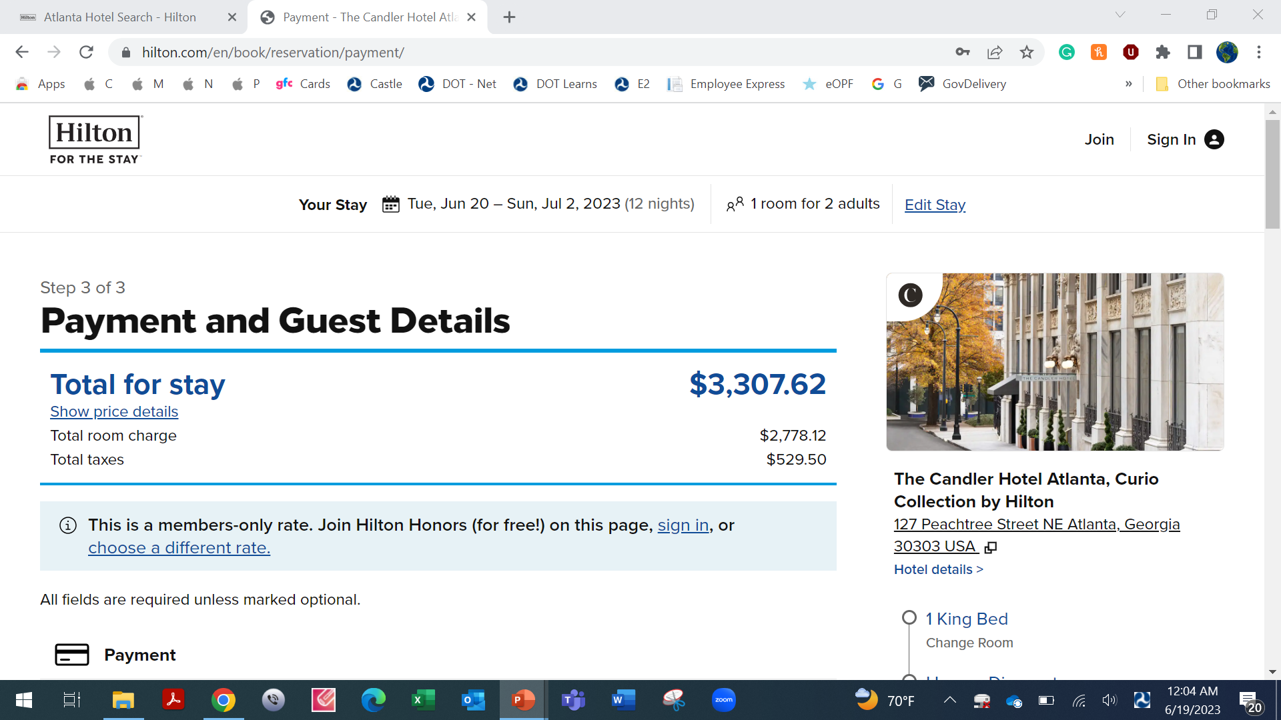

Slide 14
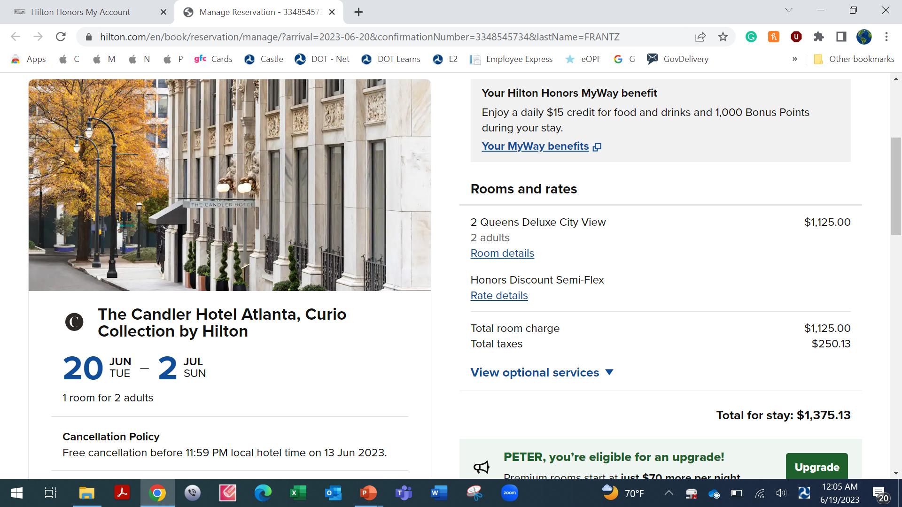

Slide 19
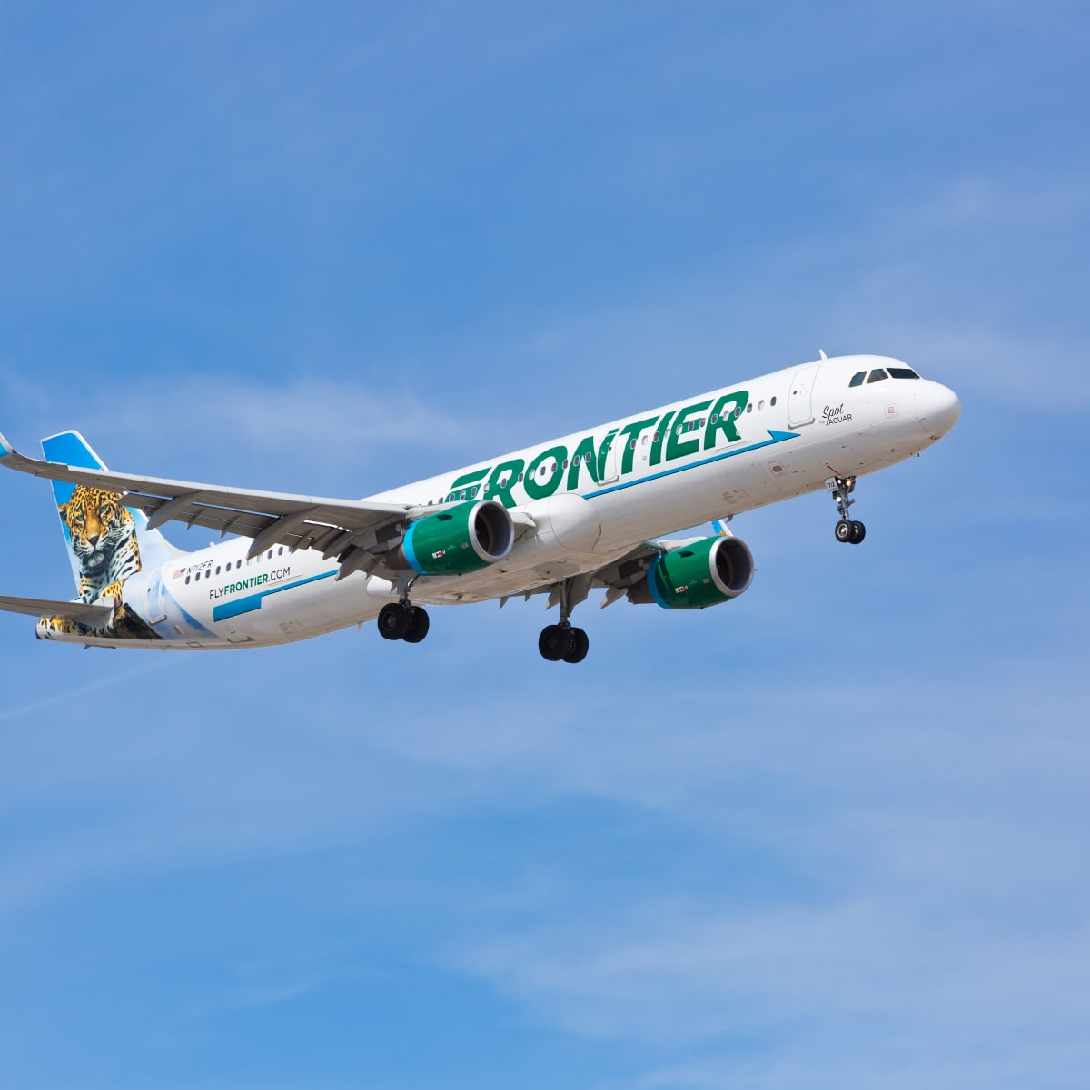
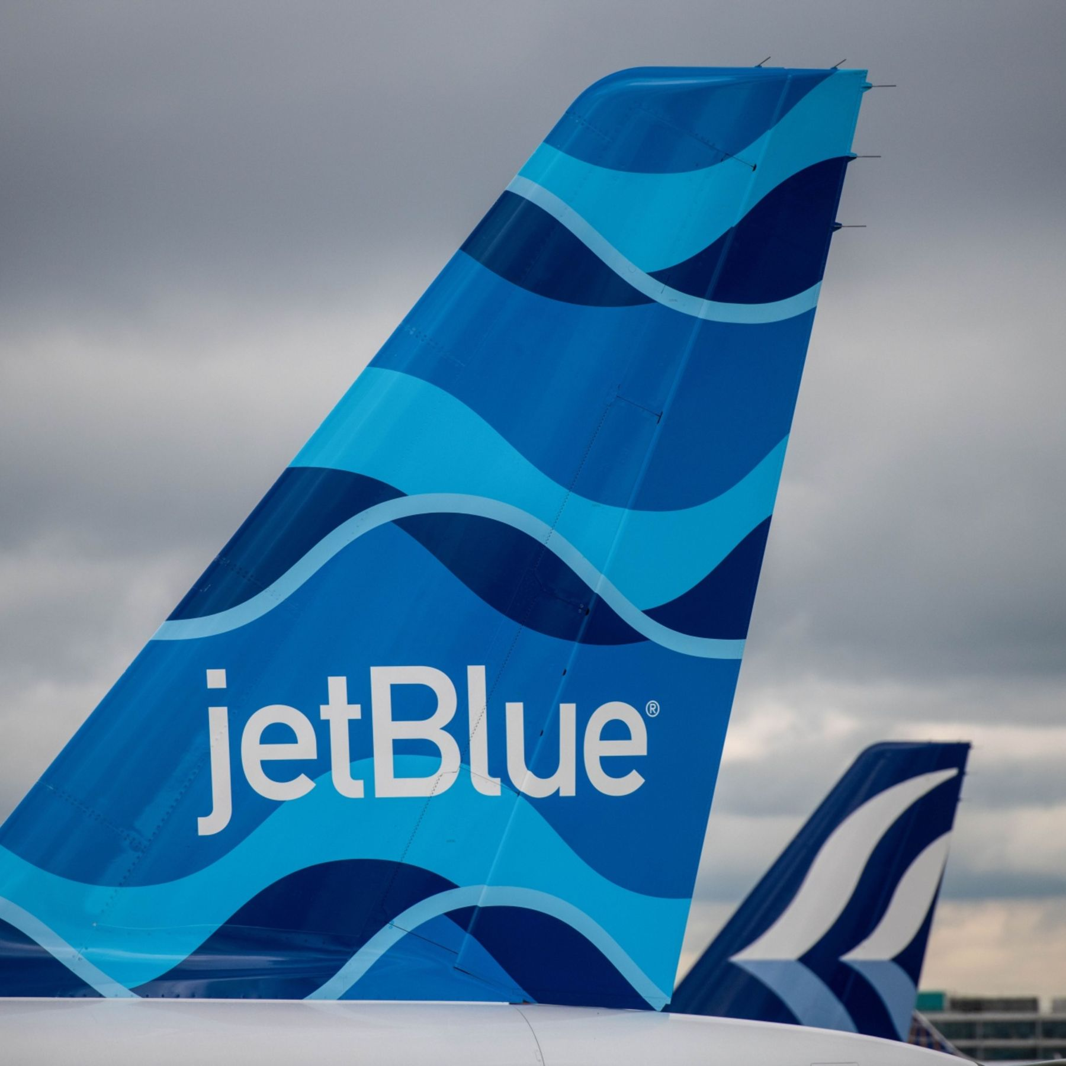
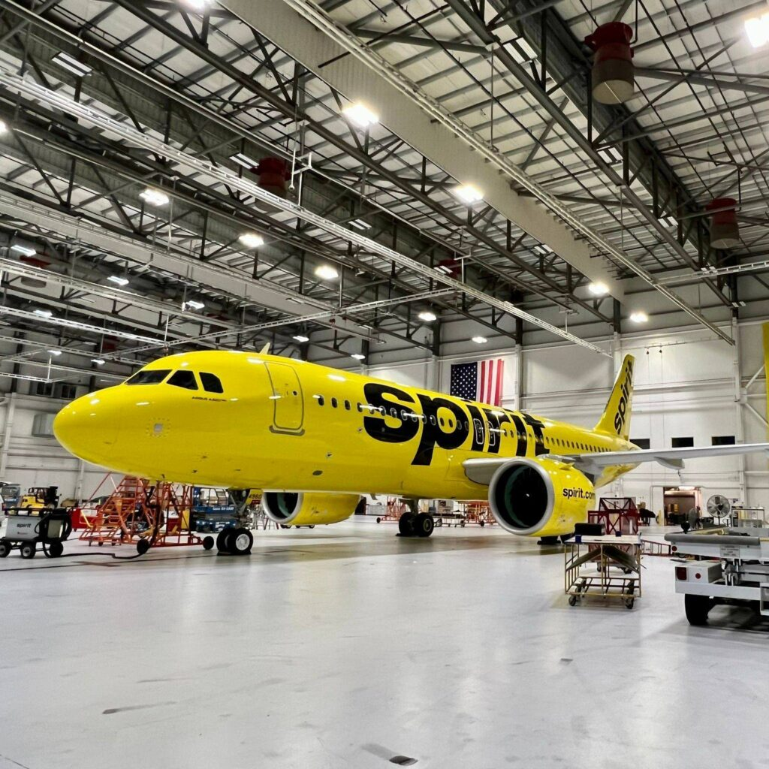
Travel On a Dime America’s Budget Airline Carriers

Slide 20
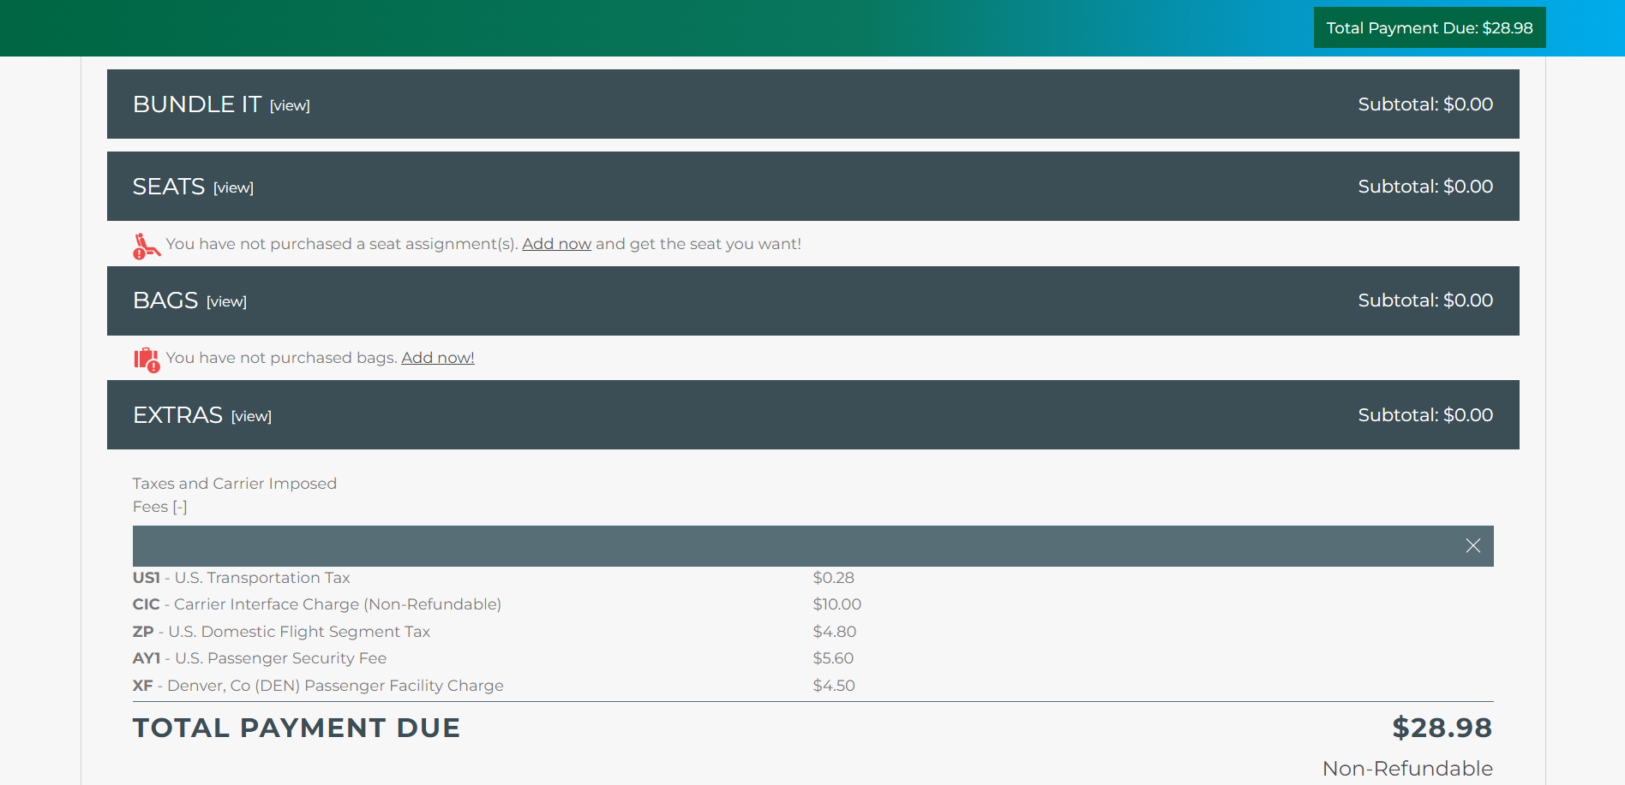

Slide 21
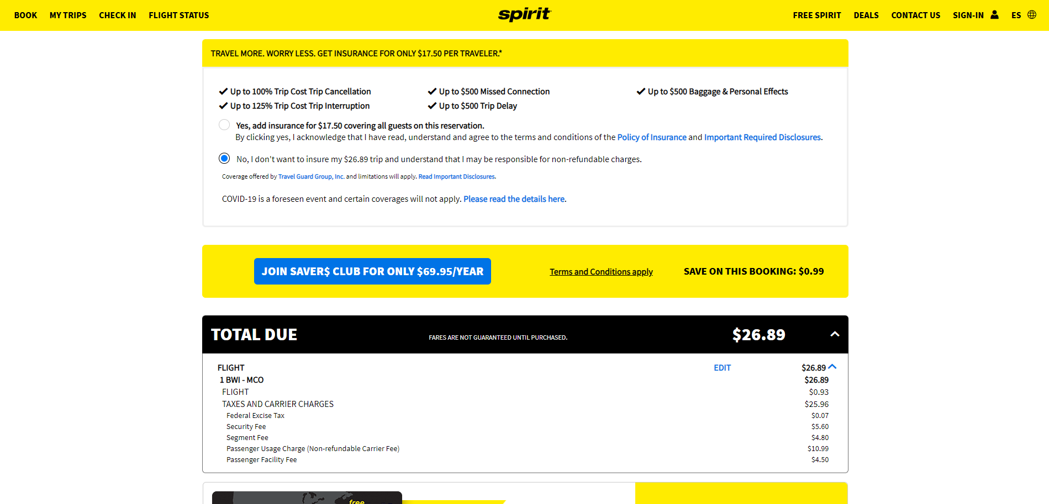

Slide 23
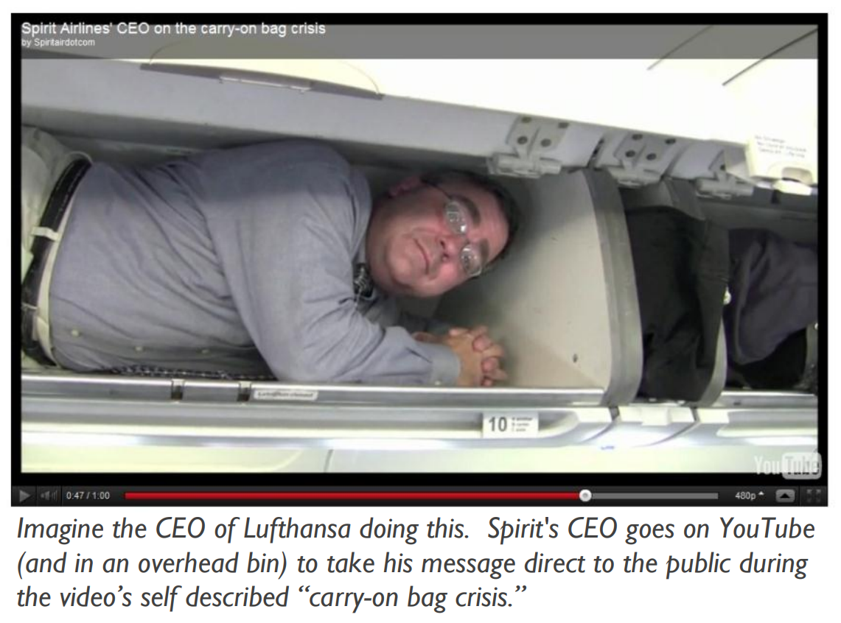

Slide 26
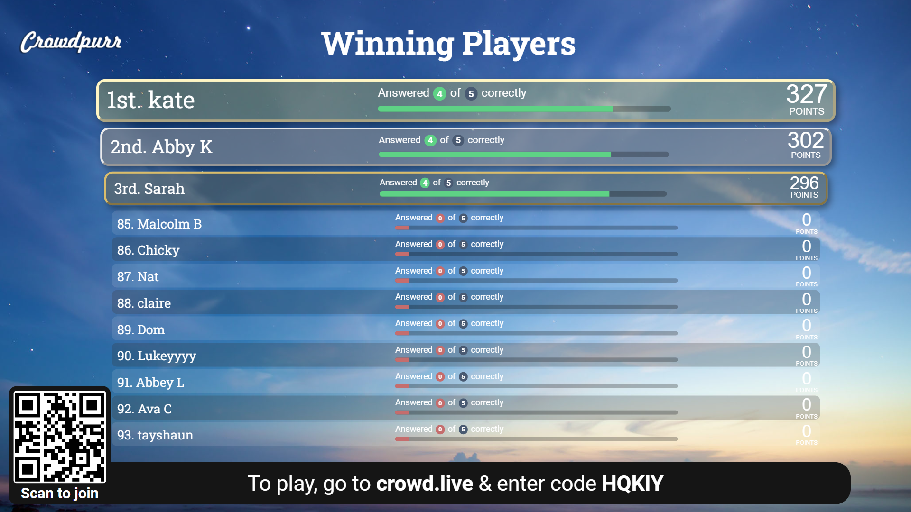

Slide 27
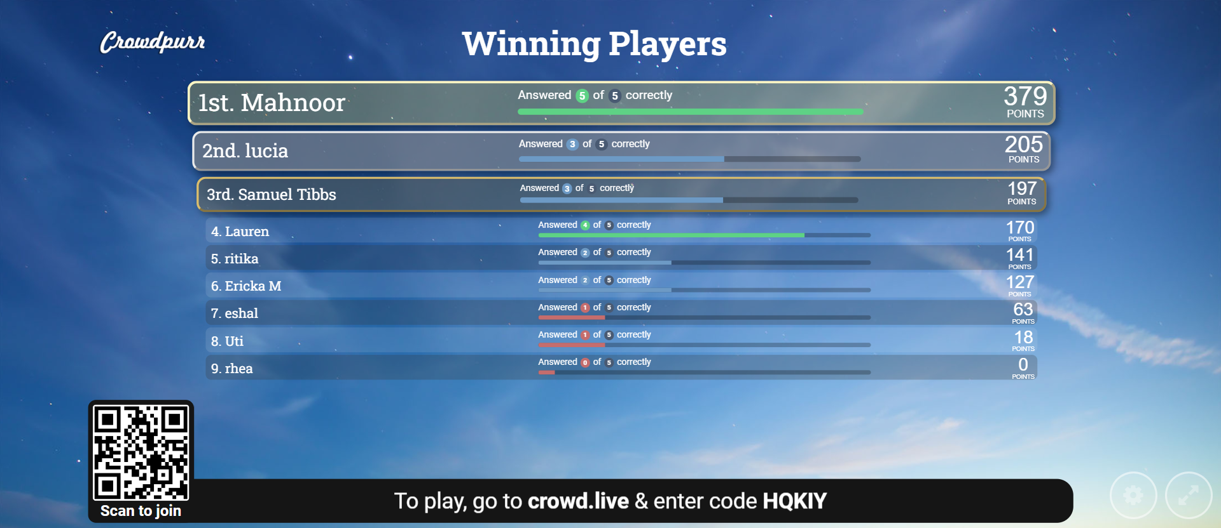

Slide 28
Travel On a Dime Questions? Questions? Questions?

